Slide 1
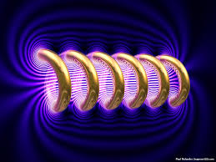
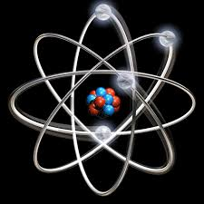

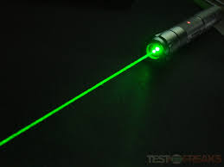
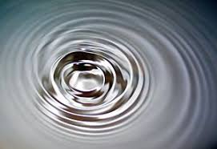
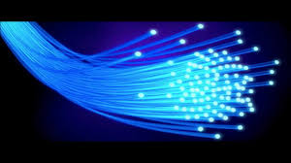
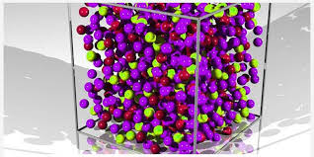
Engineering Physics
PHY-109
LASER-4
ELECTROMAGNETIC THEORY
QUANTUM MECHANICS
LASER
WAVES
Dr. Vishal Thakur
Department of Physics
Lovely Professional University
Phagwara, Punjab-144411
SOLID STATE PHYSICS
FIBER OPTICS

Slide 2
Syllabus
Fundamentals of laser- energy levels in atoms
Radiation matter interaction, Absorption of light
Spontaneous emission of light, stimulated emission of light
Population of energy levels, Einstein A and B coefficients
Metastable state, population inversion, lasing action
Properties of laser, resonant cavity, excitation mechanisms
Nd - YAG, He-Ne Laser, Semiconductor Laser
Applications of laser in engineering, holography.

Slide 3
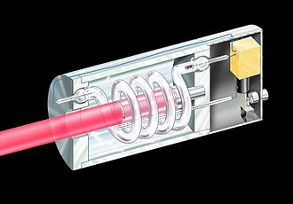
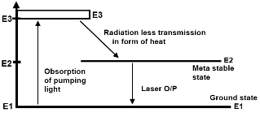
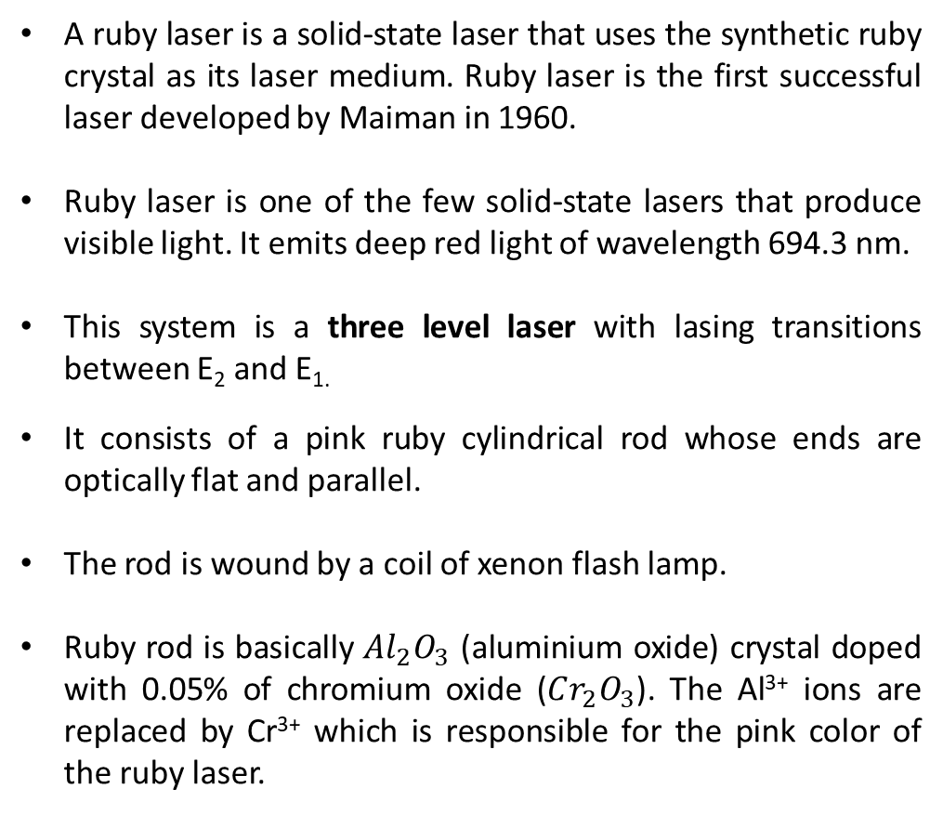
Ruby Laser
A ruby laser is a solid-state laser that uses the synthetic ruby crystal as its laser medium. Ruby laser is the first successful laser developed by Maiman in 1960.
Ruby laser is one of the few solid-state lasers that produce visible light. It emits deep red light of wavelength 694.3 nm.
This system is a three level laser with lasing transitions between E₂ and E_{1.}
It consists of a pink ruby cylindrical rod whose ends are optically flat and parallel.
The rod is wound by a coil of xenon flash lamp.
Ruby rod is basically $Al_{2}O_{3}$ (aluminium oxide) crystal doped with 0.05% of chromium oxide ($Cr_{2}O_{3}$). The Al³⁺ ions are replaced by Cr³⁺ which is responsible for the pink color of the ruby laser.
http://www.physics-and-radio-electronics.com/physics/laser/rubylaserdefinitionconstructionworking.html

Slide 4
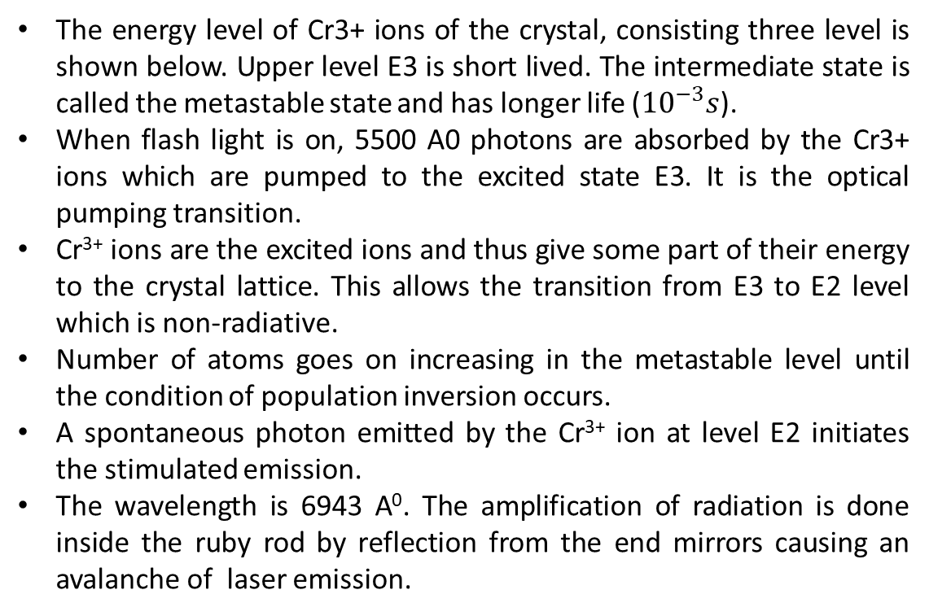
Ruby Laser: working
The energy level of Cr3+ ions of the crystal, consisting three level is shown below. Upper level E3 is short lived. The intermediate state is called the metastable state and has longer life (${10}^{−3}s$).
When flash light is on, 5500 A0 photons are absorbed by the Cr3+ ions which are pumped to the excited state E3. It is the optical pumping transition.
Cr³⁺ ions are the excited ions and thus give some part of their energy to the crystal lattice. This allows the transition from E3 to E2 level which is non-radiative.
Number of atoms goes on increasing in the metastable level until the condition of population inversion occurs.
A spontaneous photon emitted by the Cr³⁺ ion at level E2 initiates the stimulated emission.
The wavelength is 6943 A⁰. The amplification of radiation is done inside the ruby rod by reflection from the end mirrors causing an avalanche of laser emission.
http://www.physics-and-radio-electronics.com/physics/laser/rubylaserdefinitionconstructionworking.html

Slide 5
Ruby Laser: Drawbacks
The laser requires high pumping power because the laser transition terminates at the ground state and more than one half of ground state must be pumped to the higher state to achieve population inversion.
The efficiency is low (1%).
The output light is not continuous but occurs in the form of pulses of microsecond duration.
Defects due to crystalline imperfection is also there.
http://www.physics-and-radio-electronics.com/physics/laser/rubylaserdefinitionconstructionworking.html

Slide 6
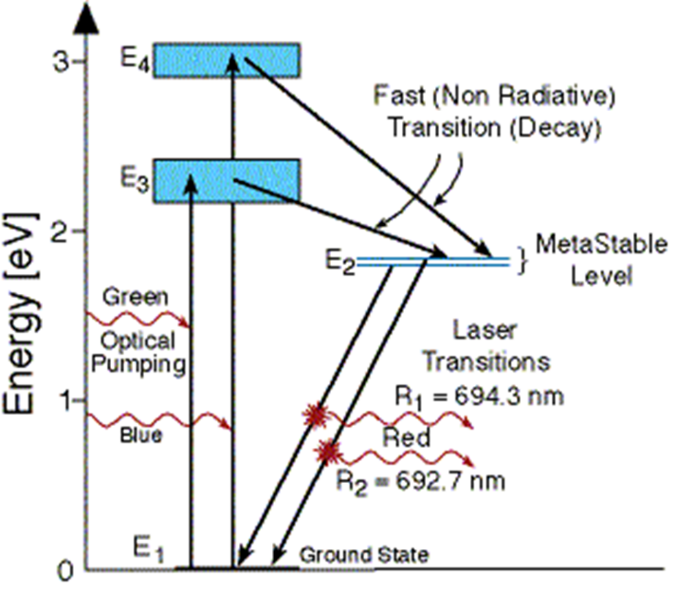
Ruby laser
Fabricated by Maiman in 1960
Solid State Laser made up of single cylindrical
crystal of Ruby of length 2 to 30 cm and
diameter 0.5 to 2 cm.
Ruby consists of Al₂O₃ doped with chromium ions (Cr³⁺)
Active medium is chromium doped Al₂O₃.
Active center is chromium ions (Cr³⁺)
Three Level Laser
Chromium Cr³⁺ replaces Al³⁺ in aluminum oxide (Al₂O₃)
Optical pumping by Xenon lamp
Optical pumping by 5500A°
Excites the of Cr³⁺ ion to higher states
If E₁ is the ground state and E₂, E₃, E₄, E₅ etc. are the first, second, third, fourth excited states then the POPULATION inversion is achieved b/w E₁ and E₂
Lasing action occurs in visible region (6943 A° or 694.3nm)
Pulsed mode (with efficiency of 1%)

Slide 7
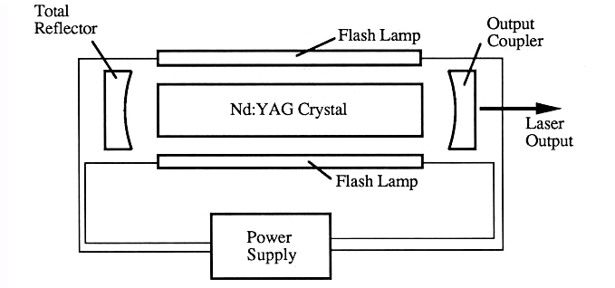
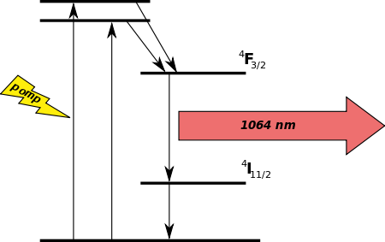
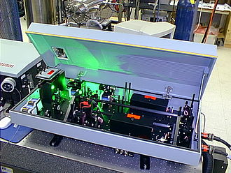
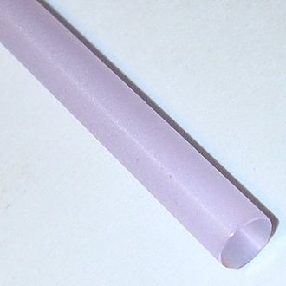
Nd-YAG Laser
Nd YAG laser rod (Source: wiki)

Slide 8
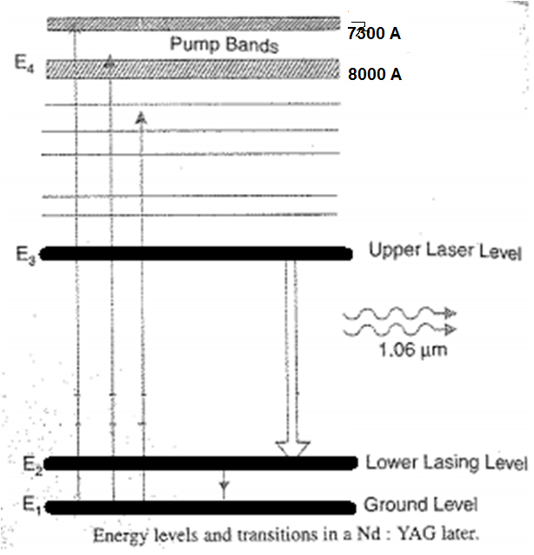

Slide 9
Nd-YAG Laser: Application
Military
Nd:YAG lasers are used in laser designators and laser rangefinders. A laser designator is a laser light source, which is used to target objects for attacking. A laser rangefinder is a rangefinder, which uses a laser light to determine the distance to an object.
Medicine
Nd: YAG lasers are used to correct posterior capsular opacification (a condition that may occur after a cataract surgery).
Nd:YAG lasers are used to remove skin cancers.
Manufacturing
Nd:YAG lasers are used for etching or marking a variety of plastics and metals.
Nd:YAG lasers are used for cutting and welding steel.

Slide 10
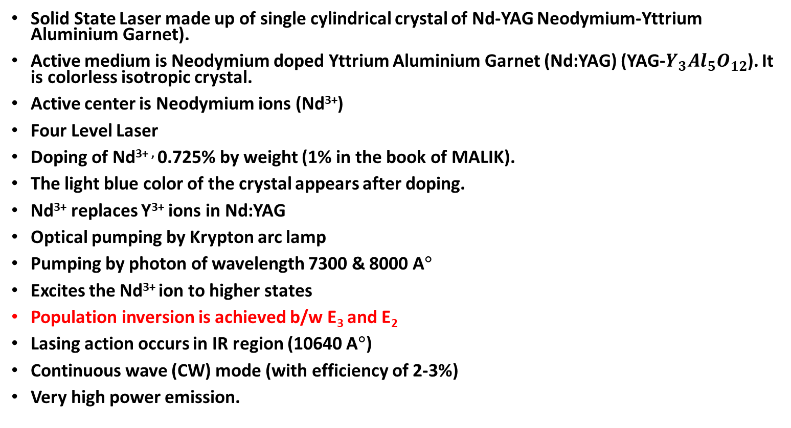
Nd-YAG Laser
Solid State Laser made up of single cylindrical crystal of Nd-YAG Neodymium-Yttrium Aluminium Garnet).
Active medium is Neodymium doped Yttrium Aluminium Garnet (Nd:YAG) (YAG-$Y_{3}Al_{5}O_{12}$). It is colorless isotropic crystal.
Active center is Neodymium ions (Nd³⁺)
Four Level Laser
Doping of Nd^{3+ ,} 0.725% by weight (1% in the book of MALIK).
The light blue color of the crystal appears after doping.
Nd³⁺ replaces Y³⁺ ions in Nd:YAG
Optical pumping by Krypton arc lamp
Pumping by photon of wavelength 7300 & 8000 A°
Excites the Nd³⁺ ion to higher states
Population inversion is achieved b/w E₃ and E₂
Lasing action occurs in IR region (10640 A°)
Continuous wave (CW) mode (with efficiency of 2-3%)
Very high power emission.

Slide 11
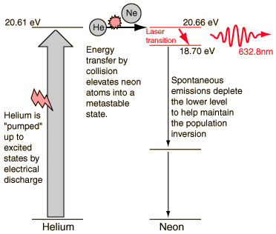
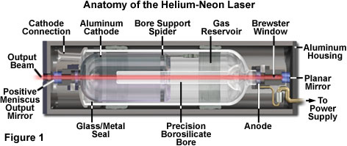

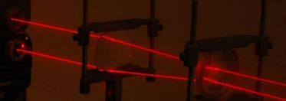
He-Ne Laser
http://hyperphysics.phy-astr.gsu.edu/hbase/optmod/lasgas.html

Slide 12
He-Ne Laser
It is a four level laser, built by Ali Javan, W. Bennet and D. Herriot in 1961.
It consists of a long discharge tube containing Helium and Neon in the ratio 10:1 at a pressure of 1 torr (0.00131579 atm).
Both the ends of the tube contain plane parallel mirrors, one of them being partially silvered/reflecting.
An electric discharge is produced in the gas by means of electrodes outside the tube, connected to a source of high frequency alternating current.
When the power is switched on, the electrons from the discharge collide with He and Ne atoms and pump them to metastable state of 20.61 eV and 20.66 eV.
Some of the excited He atoms transfer their energy to ground state Ne atoms through collisions.
The laser transition occurs between 20.66 eV and 18.70 eV energy levels of Ne atoms. The wavelength of emitted photon is 6328 A⁰.
The Ne atoms passes from 18.70 eV to a lower metastable state spontaneously emitting incoherent light. Finally, the Ne atoms come down to the ground state through collision with the tube walls which is a radiation less transition.
This laser operates in a continuous mode and not in pulsed as Ruby laser.

Slide 13
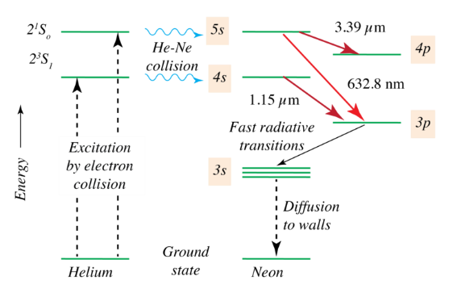
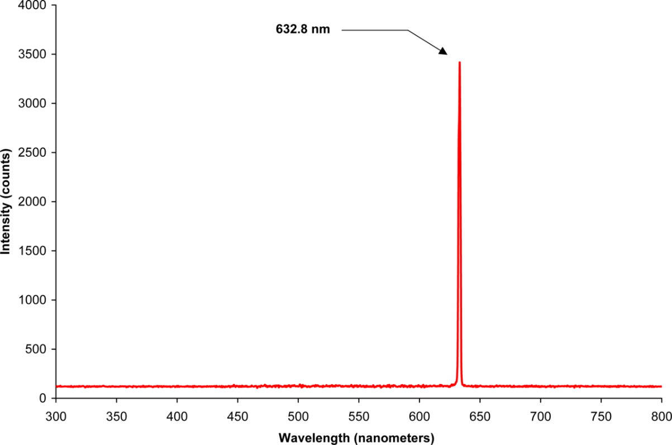
He-Ne Laser
Source: Wikipedia
The first HeNe lasers emitted infrared at 1.15 μm, and were the first gas lasers. However, a laser that operated at visible wavelengths was much more in demand, and a number of other neon transitions were investigated to identify ones in which a population inversion can be achieved. The 632.8 nm line was found to have the highest gain in the visible spectrum, making this the wavelength of choice for most HeNe lasers. However other visible as well as infrared stimulated emission wavelengths are possible, and by using mirror coatings with their peak reflectance at these other wavelengths, HeNe lasers could be engineered to employ those transitions. This includes visible lasers appearing red, orange, yellow, and green. The 3.39 μm transition has a very high gain but is prevented from use in an ordinary HeNe laser (of a different intended wavelength) because the cavity and mirrors are lossy at that wavelength. However in high power HeNe lasers having a particularly long cavity, superluminescence at 3.39 μm can become a nuisance, robbing power from the stimulated emission medium, often requiring additional suppression

Slide 14
He-Ne Laser: Requirement of He atoms
Why He atoms are required?
Electric discharge excite both He and Ne atoms. But to achieve rapid population inversion He atoms are required. He atoms can transfer their energy in the excited state to the ground state Ne atoms via collision. But, He has 20.61 eV energy and Ne requires 20.66 eV. The difference in energy 0.05 eV comes with the kinetic energy of the He atoms.
Thus, the only purpose of He atom is to help Ne atoms achieve population inversion.

Slide 15
He- Ne laser
Gas Laser
Four Level Laser
Active medium: Mixture of He and Ne gases
He and Ne in the ratio of 10:1 at low pressure (∼1 torr) or 1mm of mercury.
Pumping: Electric discharge
Active centers: Ne atoms
Energy transfer through collision (He collides with Ne)
Ne atoms are excited by the collision of excited He atoms
Population inversion is achieved b/w E₄ (20.66eV) and E₃(18.7eV)
Lasing output 6328 A° or 632.8nm
Continuous wave (CW) mode

Slide 16
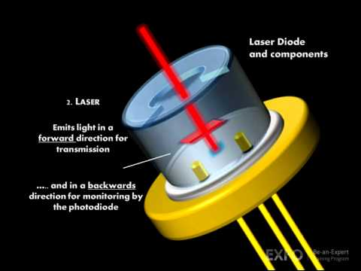
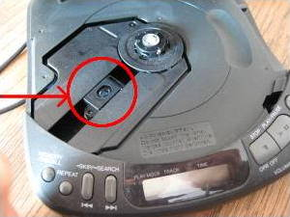
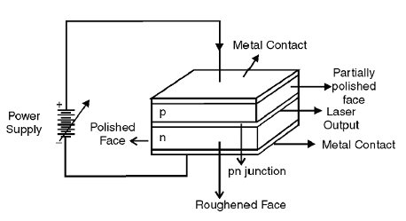
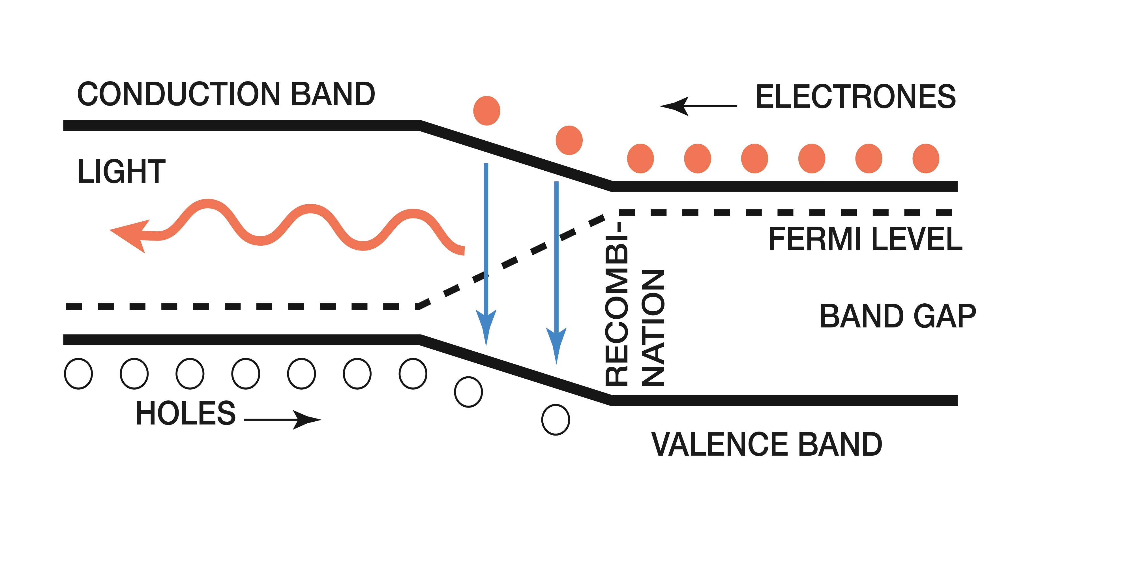
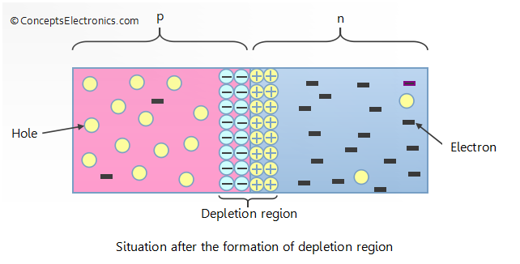
Semiconductor Laser

Slide 17
Semiconductor Laser
Specially fabricated p-n junction device
Emits coherent light when it is forward biased
R.N. Hall and coworkers made first semiconductor in 1962
Made from GaAs operated at very low temperature
Semiconductor lasers working at room temperature and in continuous wave mode were produced in 1970.

Slide 18
Semiconductor Laser
Diode lasers are small in size (0.1 mm long)
High efficiency of the order of 40%
Operate at low powers still produces power output equivalent to that of He-Ne laser
Portable
Used in optical fiber communication, in CD players, CD-ROM derives, optical reading, high speed laser printing etc.
GaAS laser emits light at a wavelength of 9000 A° in IR region

Slide 19
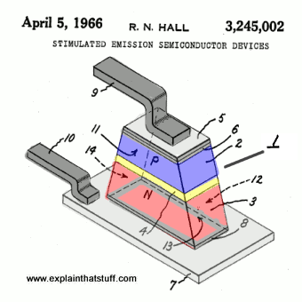
Semiconductor Laser: History
General Electric's Dr. Robert N. Hall, filed his patent for the idea ("Stimulated emission semiconductor devices") on October 24, 1962 (it was granted as US Patent #3,245,002 on April 5, 1966).
A typical P-N semiconductor laser diode.
P-type region (blue).
N-type region (red).
P-N junction region (resonant cavity) where light is produced by stimulated emission. This isn't drawn to scale! In Hall's original patent, it's described as being 0.1 micron (0.1 millionths of a meter, 0.1μm, or 1000 Angstroms) thick.
Upper electrode.
Solder fixing upper electrode to p-type region.
Lower electrode.
Solder fixing lower electrode to n-type region. (This covers the whole of the base of the n-type region, not just the gray outer outline shown here.)
Upper electrode connector.
Lower electrode connector.
Highly polished front surface.
Highly polished rear surface, which must be precisely parallel to the front surface to ensure standing waves of electromagnetic radiation (laser light) are produced and emitted efficiently in the resonant cavity between the p-type and n-type regions. Surfaces 11 and 12 may be covered with mirrors or a metallic coating to improve the resonant effect.
Side surface cut at an angle (or roughened) to prevent waves of light forming in other directions.
Other side surface cut at a similar angle or roughened in a similar way.
http://www.explainthatstuff.com/semiconductorlaserdiodes.html

Slide 20
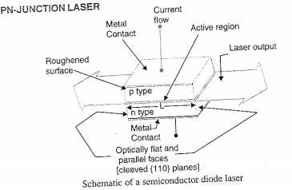
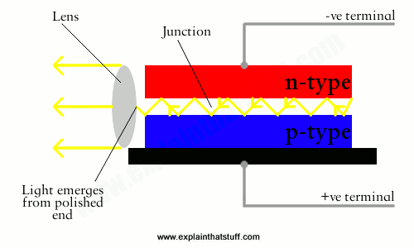
Semiconductor Laser: How does it work?
The laser light is emitted due to the electron-hole recombination in the junction.
When electrons in the conduction band run into the valence band, they will combine with holes and at the same time they emit radiation of definite energy.
The pumping of semiconductor laser can be realized by beam of another laser, or by electron beam. But, the most convenient way is to use electrical current to flow through the semiconductor junction. This uses semiconductor laser in the form of diode.
The active medium is the junction which is forward biased. The junction is few micrometer thick.
In general, the laser light can be emitted through both the ends, but if it is required through one end only, then the other end is polished fully.
Unlike other lasers, semiconductor laser does not need extra mirrors to obtain the reflectivity needed to produce the feedback mechanism.
Conduction Band
E_{g}
Forbidden Band
Valence Band

Slide 21
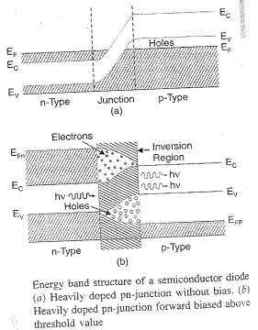
Semiconductor Laser: Common Material
Common materials for semiconductor lasers (and for other optoelectronic devices) are
GaAs (gallium arsenide)
AlGaAs (aluminum gallium arsenide)
GaP (gallium phosphide)
InGaP (indium gallium phosphide)
GaN (gallium nitride)
InGaAs (indium gallium arsenide)
GaInNAs (indium gallium arsenide nitride)
InP (indium phosphide)
GaInP (gallium indium phosphide)
https://www.rp-photonics.com/semiconductor_lasers.html

Slide 22
Laser Diode and LED
Energy is needed to create electron hole pair and this energy is released when an electron and hole recombines.
In silicon and Germanium the recombination energy is absorbed by the crystal as heat.
In certain other semiconductor, such as gallium arsenide, a photon is emitted when recombination occurs.
This is the basis of LED (Light Emitting Diode).
Forward bias is used in an LED, so he electrons and holes both move towards the p-n junction where they recombine to create photons.
A fairly small current is used in LED and the photons are produced by spontaneous emission.
When current is high, spontaneous emission may not keep up with rate of arrival of electrons and holes in the depletion region, and the result is a substantial population inversion there. This is the condition of laser action to occur.
Any spontaneous emission of photon will cause avalanche of photons by stimulated emission.
The coherent light is produced as the stimulated emission is intensified as it moves back and forth in the thin depletion layer and emerges through the ends.

Slide 23
Semiconductor Laser: LED Vs. Laser
specification | Light Emitting Diode | Laser Diode
Output power | Linearly proportional to drive current | Proportional to current above the threshold
Current | Drive Current (50 to 100 mA) (Peak) | Threshold current (5 to 40 mA)
Coupled power | Moderate | High
Speed | Slower | Faster
Output pattern | Higher | Lower
Fiber Type | Multimode only | Singlemode and multimode
Ease of use | Easier | Harder
Lifetime | Longer | Long
Spectral width | Wider, 25 to 100 nm (10 to 50 THz) | Narrower, <10⁻⁵ to 5 nm (<1 MHz to 2 MHz)
Modulation Bandwidth | Moderate, Tens of KHz to tens of MHz | High, Tens of MHz to tens of GHz
Available Wavelength | 0.66 to 1.65 mm | 0.78 to 1.65 mm
E/O Conversion Efficiency | 10 to 20 % | 30 to 70 %
Eye Safety | Generally considered eye-safe | Must be rendered eye-safe, especially for λ < 1400 nm
Cost | Low | Moderate to High
http://www.rfwireless-world.com/Terminology/LED-vs-Laser.html

Slide 24
Semiconductor Laser: Use
CD/DVD players
Laser pointers
Laser sights
Navigation
Medicine: photocoagulation, photo thermal ablation etc.
Fiber optic cable.

